Slide 1
Performance and Benchmarking with Hitachi UCP HC
(All-NVMe, Skylake-SP and Cascade Lake-SP/Persistent Memory)
Jose Perez
Converged Product Engineering
June 2019

Slide 2
Content
Objectives
Summary of Results
Solution Components
UCP HC Configurations
Workloads and Test Cases
UCP HC All-NVMe Vs SATA SSD – HCIBench (All Skylake CPU)
UCP HC All-NVMe Vs SATA SSD - HammerDB (All Skylake CPU)
UCP HC All-NVMe - Skylake vs Cascade/AEP
Test Cases & Results
Findings & Conclusions

Slide 3
Objectives
Perform benchmarks on Hitachi UCP HC All-NVMe with Cascade CPU and Intel® Optane DC Persistent Memory (DCPMM).
Perform benchmarks on UCP HC based on SATA SSD, NVMe + SATA SSD and All-NVMe solutions.
Compare results with UCP HC based on Skylake CPU.

Slide 4
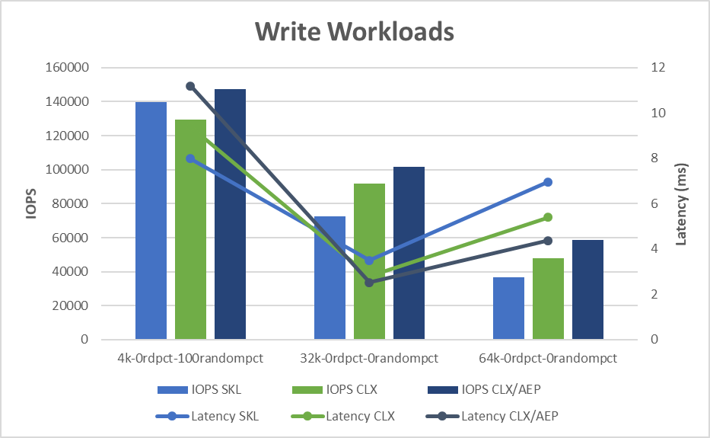
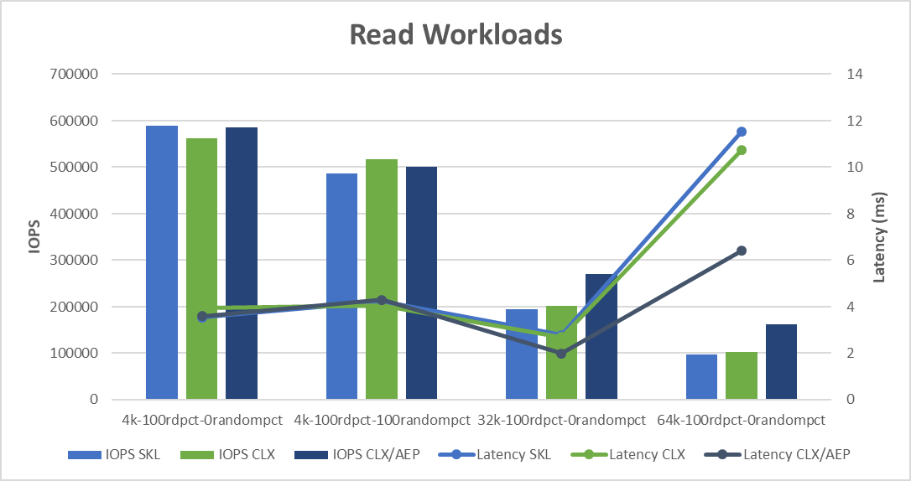
Summary of HCIBench Results
HCIBench Results – SKL Vs CLX/AEP Configurations
Charts below show the results of HCIBench tests executed on UCP HC All-NVMe with Skylake (SKL) and Cascade/AEP (CLX/AEP) configurations.
Detailed results and highlights on section Workloads and Tests Results

Slide 5
Solution Components

Slide 6
Solution Components
UCP HC All-NVMe – Configurations:
4-node UCP HC Cluster
Hardware | Description | Skylake-SP | Cascade Lake-SP/AEP
 |  | V124N (SKL) | CLX | CLX/AEP
System | Hitachi Advanced Server DS120 | 1 | 1 | 1
CPU | Intel(R) Xeon(R) Platinum 8276L (28 cores, 2.20GHz) (Cascade Lake-SP) | - | 2 | 2
 | Intel(R) Xeon(R) Gold 6140 (18 cores, 2.3GHz) (Skylake-SP) | 2 | - | -
Memory | 32GB 2666 MHz DDR4 RDIMM | 8 x 32GB (256GB) | 12 x 32GB (384GB) | 8 x 32GB (256 GB)
 | 128GB Intel Optane DC Persistent Memory (in Memory Mode) |  | - | 4 x 128 GB (512 GB)
Cache Tier | Intel Optane SSD DC P4800X (375GB, U.2) NVMe | 2 | 2 | 2
Capacity Tier | Intel SSD DC P4510 (4TB, U.2) NVMe | - | 6 | 6
 | Intel SSD DC P4510 (1TB, U.2) NVMe | 6
Network | Intel Ethernet Network Connection X722 (Quanta X527-DA4 10GbE, quad-port, OCP) | 1 | 1 | -
 | Intel Ethernet Network Adapter XXV710-2 25GbE, dual-port |  | - | 1
Boot Device | SATADOM SLC 32GB | 1 | 1 | 1
Mgmt. Network | 1 GbE Mgmt. Network | 1 | 1 | 1
Text Example

Slide 7
Solution Components
UCP HC– Network Switches
10/25 GbE Network Support:
Hardware | Description | Qty
Top-of-Rack Switch | Cisco Nexus 93180YC-EX 48-port 10/25GbE | 2
Mgmt. Switch | Cisco Nexus 3840TP 48-port 1GbE | 1
Text Example

Slide 8
Solution Components
Software/Firmware:
Software | Servers w/SKL | Servers w/CLX/AEP
VMware vCenter Server | vCenter 6.7.0 Build 9232942 | 6.7.0 U1 Build 10244857
VMware ESXi | ESXi 6.7.0 Build 9214924 | 6.7.0 U1 Build 10764712 (EP5)
VMware vSAN | 6.7 | 6.7.0 EP5
HCIBench/ Vdbench | 1.6.7.1 / 5.04.07 | 2.0 / 5.04.07
Firmware:
BMC | 4.23.06 | 4.57.06
BIOS | 3A10.H7 | S5BH3B13.H00
CPLD | 10 | 11
Intel Optane SSD DC P4800X | E2010324 | E2010435
Intel SSD DCP4510 | VDV10131 | VDV10131
Intel Optane DC Persistent Memory | N/A | 1.2.0.5375 and API version 1.15 ( BKC 2019 WW16)

Slide 9
Solution Components
Firmware and Software Optimizations:
Setting | Servers w/SKL | Servers w/CLX/AEP
Intel® Hyper Threading Technology | Enabled (default: Enabled) | Enabled (default: Enabled)
Intel® Turbo Boost Technology | Enabled (default: Enabled) | Enabled (default: Enabled)
Hardware P-states (HWP) | default: Out of Band Mode | Native Mode (default: Out of Band Mode)
C-States | Disabled (default: Enabled) | Disabled (default: Enabled)
LLC prefetch | default: Disabled | Enabled (default: Disabled)
BIOS Power and Performance Settings | High Performance (default: Custom) | High Performance (default: Custom)
ESXi Power Management Policy | High Performance (default: Balanced) | High Performance (default: Balanced)
Intel® Trusted Execution Technology (Intel TXT) | Enabled (default: Disabled) | Enabled (default: Disabled)
Trusted Platform Module (TPM) 2.0 | N/A | TPM 2.0 Installed and Enabled
Intel® Volume Management Device (Intel VMD) | Enabled (default: Disabled) | Enabled (default: Disabled)

Slide 10
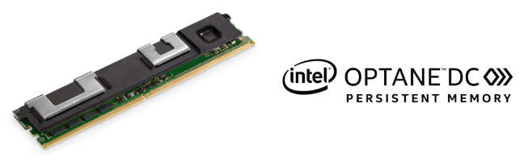
CLX/AEP Memory Population
AEP DIMM Population
Tests executed with 3 different memory populations
Memory Population within the Socket
 | iMC1 |  |  |  |  |  | iMC0
 | Channel 2 |  | Channel 1 |  | Channel 0 |  | Channel 2 |  | Channel 1 |  | Channel 0 |  |  | Total DIMMs/Server
Modes | Slot F1 | Slot F0 | Slot E1 | Slot E0 | Slot D1 | Slot D0 | Slot C1 | Slot C0 | Slot B1 | Slot B0 | Slot A1 | Slot A0 | Config#
MM |  |  | AEP | DRAM | AEP | DRAM |  |  | AEP | DRAM | AEP | DRAM | 2-2-0 | (8 x 32GB + 8 x 128GB)
MM |  | AEP |  | DRAM |  | DRAM |  | AEP |  | DRAM |  | DRAM | 1-1-1 | (8 x 32GB + 4 x 128GB)
MM |  |  |  | AEP |  | DRAM |  |  |  | AEP |  | DRAM | 1-1-0 | (4 x 32GB + 4 x 128GB)
MM: Memory Mode
Note: More details about AEP DIMM population on slides and the end of the doc

Slide 11
Workloads and Test Results

Slide 12





UCP HC/HCIBench Configurations
UCP HC/ HCIBench Benchmark Configuration
Except one test case, all the other tests cases were executed with HCIBench
System Under Test (SUT)
HCIBench VMs
VMware vSAN
UCP HC All-NVMe CLX/AEP
(Hitachi Advanced Server DS120)

Slide 13
UCP HC/HCIBench Configurations
UCP HC/ HCIBench Configuration
4-node vSAN cluster configured, each host with 2 disk groups
Dedupe/Compression disabled
Default vSAN VM Storage Policy
VM Configuration:
16 VMs deployed in cluster (4/host, 2/disk group)
8 VMDK’s per VM
50 and 100GB per VMDK depending on size of vSAN datastore
Clear Read/Write cache before each testing
VMDKs initialized with the HCIBench "Zero" option (which uses FIO) before running a workload
VMs evenly distributed across all hosts in the cluster
Each test executed for 30min with 10min warmup

Slide 14
UCP HC All-NVMe Vs SATA SSD (with HCIBench)

Slide 15
Test Cases : HCIBench Workloads
UCP HC – All-NVMe Vs SATA SSD Configurations (Skylake)
Tested with four different configurations of UCP HC, using SATA SSD, NVMe + SATA SSD and All-NVMe:
Config 1: UCP HC V121F (SATA SSD for Cache + SATA SSD for Capacity)
Config 2: UCP HC V120F (P46x0 NVMe for Cache + SATA SSD for Capacity)
Config 3: UCP HC V123F (Optane NVMe for Cache + SATA SSD for Capacity)
Config 4: UCP HC V124N (Optane NVMe for Cache + P45x0 NVMe for Capacity)

Slide 16
Solution Components
UCP HC All-NVMe – Configurations:
4-node UCP HC Cluster
The servers on the vSAN cluster were configured as indicated below:
Hardware | Description | Skylake-SP
 |  | V121F | V120F | V123F | V124N
System | Hitachi Advanced Server DS120 | 1 | 1 | 1 | 1
CPU | Intel(R) Xeon(R) Gold 6140 (18 cores, 2.3GHz) (Skylake-SP) | 2 | 2 | 2 | 2
Memory | 32GB 2666 MHz DDR4 RDIMM | 8 x 32GB (256GB) | 8 x 32GB (256GB) | 8 x 32GB (256GB) | 8 x 32GB (256GB)
Cache Tier | Intel SSD DC S46x0 (960GB, 2.5” U.2) | 2 | - | - | -
 | Intel SSD DC P4610 (1.6TB, U.2) NVMe | - | 2 | - | -
 | Intel Optane SSD DC P4800X (375GB, U.2) NVMe | - | - | 2 | 2
Capacity Tier | Intel SSD DC S4500 (1.92TB, 2.5” U.2) | 6 | 6 | 6 | -
 | Intel SSD DC P4510 (1TB, U.2) NVMe | - | - | - | 6
Network | Intel Ethernet Network Connection X722 (Quanta X527-DA4 10GbE, quad-port, OCP) | 1 | 1 | 1 | 1
Boot Device | SATADOM SLC 32GB | 1 | 1 |  | 1
Mgmt. Network | 1 GbE Mgmt. Network | 1 | 1 |  | 1
Text Example

Slide 17
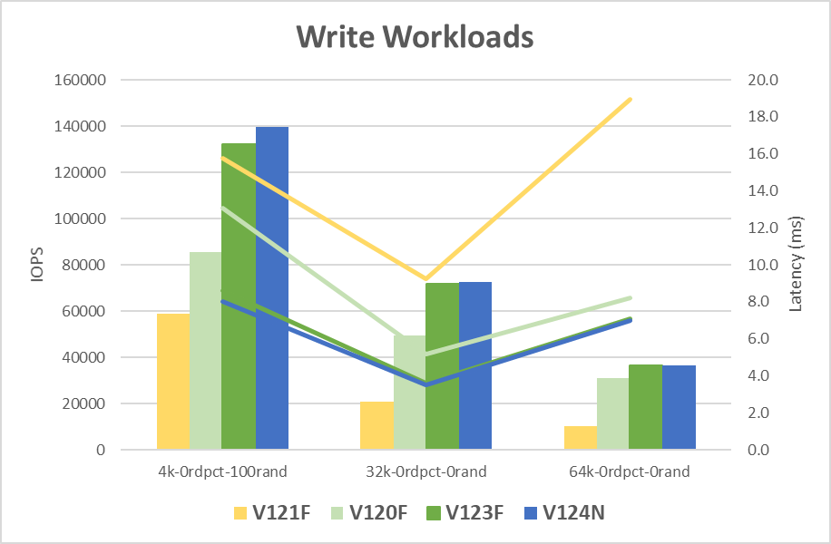
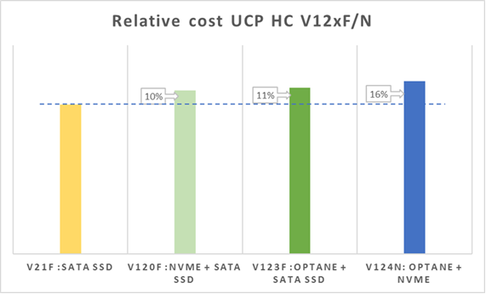
Test Cases : HCIBench Workloads/Results
UCP HC – All-NVMe Vs SATA SSD Results
Note: based on COG at November 2018
The big difference when comparing performance results between SATA SSD Vs All-NVMe clusters is for Write-intensive workloads.
The total max IOPS achieved in an All-NVMe cluster could be 2 to 3 times the IOPS achieved on a SATA SSD cluster, while latency could be 1.3 to 3.3 times lower on the All-NVMe cluster.
On the other side, all these gains in IOPS (2-to-3 times) and lower latency (up to 3x lower) can be achieved with only a small delta in cost (16% ).

Slide 18
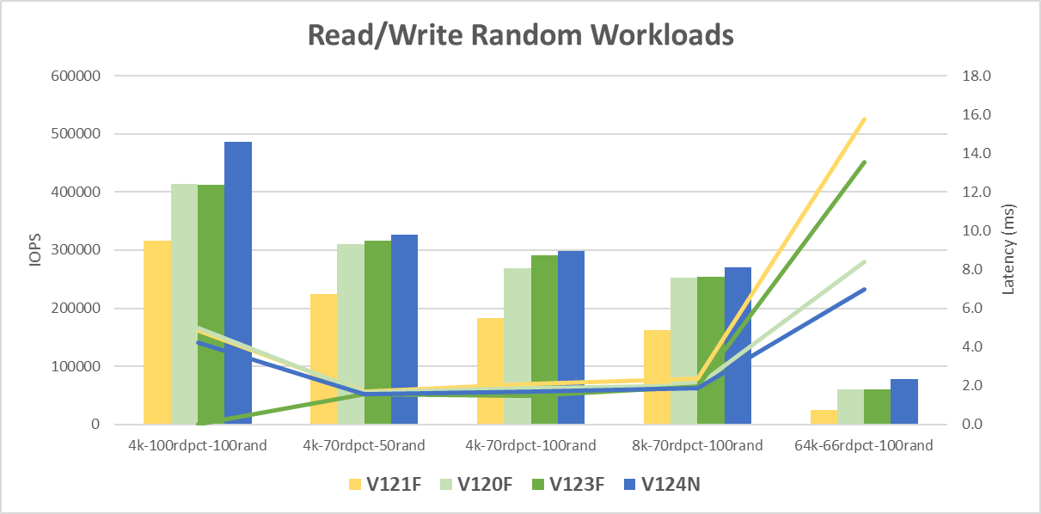
Test Cases : HCIBench Workloads
UCP HC – All-NVMe Vs SATA SSD Results

Slide 19
Test Cases : HCIBench Workloads
UCP HC – All-NVMe Vs SATA SSD Results
More details about these performance tests can be found on the following Tech Note:
Performance and Benchmarking Hitachi Unified Compute Platform HC Using an All-NVMe Configuration
https://knowledge.hitachivantara.com/@api/deki/files/48613/FE-SL-110-00.pdf7?revision=1

Slide 20
UCP HC All-NVMe Vs SATA SSD (with HammerDB)

Slide 21
Test Cases : HammerDB Workloads
UCP HC – All-NVMe Vs SATA SSD - HammerDB
UCP HC was tested with HammerDB running a TPC-C like workload on Microsoft Windows Server 2016 and Microsoft SQL Server 2016 virtual machines. Two configuration were used for these tests:
Config 1: UCP HC V121F (SATA SSD for Cache + SATA SSD for Capacity)
Config 2: UCP HC V124N (Optane NVMe for Cache + P45x0 NVMe for Capacity)
Hardware | Description | Skylake-SP
 |  | V121F | V124N
System | Hitachi Advanced Server DS120 | 1 | 1
CPU | Intel(R) Xeon(R) Gold 6140 (18 cores, 2.3GHz) (Skylake-SP) | 2 | 2
Memory | 32GB 2666 MHz DDR4 RDIMM | 12 x 32GB (384GB) | 12 x 32GB (384GB)
Cache Tier | Intel SSD DC S46x0 (960GB, 2.5” U.2) | 2 | -
 | Intel Optane SSD DC P4800X (375GB, U.2) NVMe | - | 2
Capacity Tier | Intel SSD DC S4500 (1.92TB, 2.5” U.2) | 6 | -
 | Intel SSD DC P4510 (1TB, U.2) NVMe | - | 6
Network | Intel Ethernet Network Connection X722 (Quanta X527-DA4 10GbE, quad-port, OCP) | 1 | 1
Boot Device | SATADOM SLC 32GB | 1 | 1
Mgmt. Network | 1 GbE Mgmt. Network | 1 | 1

Slide 22
Test Cases : HammerDB Workloads
UCP HC – All-NVMe Vs SATA SSD – HammerDB
Tables below show the configuration for HammerDB and the SQL Server VMs:

Slide 23
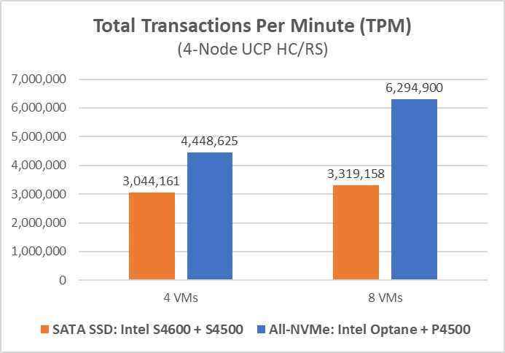
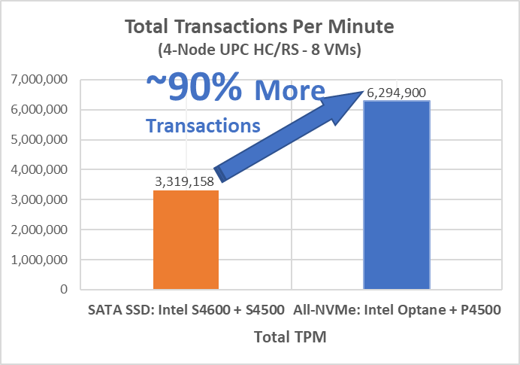
Test Cases : HammerDB Workloads/Results
UCP HC – All-NVMe Vs SATA SSD - HammerDB

Slide 24
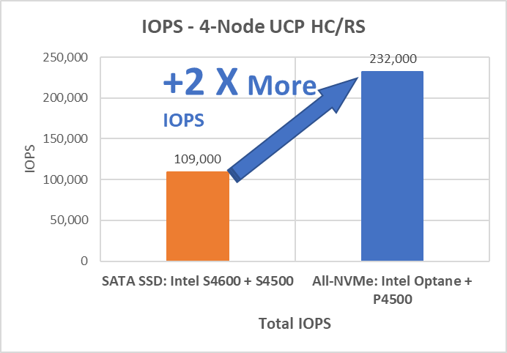
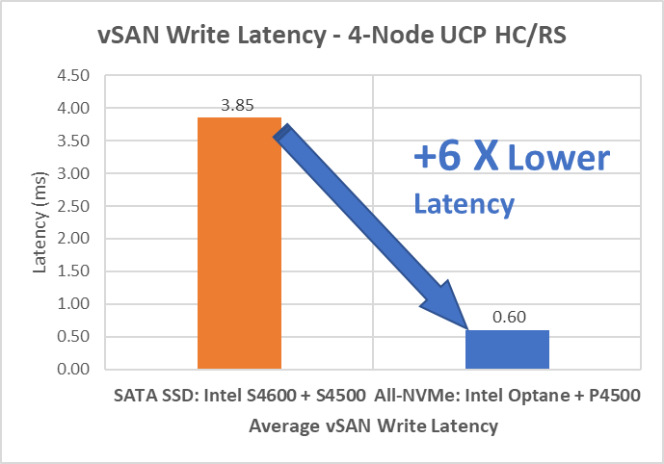
Test Cases : HammerDB Workloads/Results
UCP HC – All-NVMe Vs SATA SSD - HammerDB

Slide 25
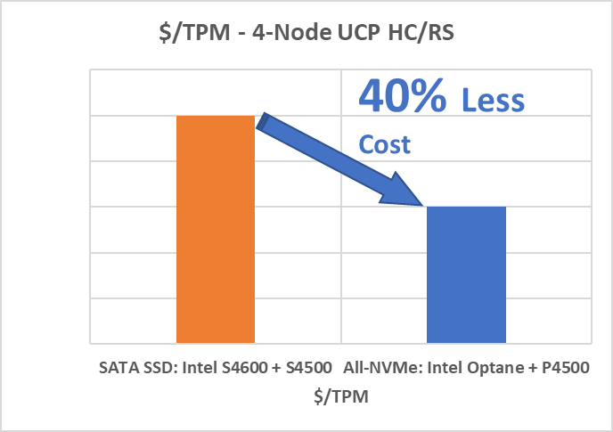
Test Cases : HammerDB Workloads
UCP HC – All-NVMe Vs SATA SSD - HammerDB
In summary, for an OLTP application, an All-NVMe cluster shows about 90% more transactions per minute (TPM) than the SATA SSD cluster.
The All-NVMe cluster has 2 times more IOPS and more than 6 times lower latency.
When comparing the TPM per price, the all-NVMe solution can be even about 40% lower in cost (TPM/dollar). For the cost analysis, both solutions were compared using capacity drives that accounted for the same total raw capacity on a vSAN datastore.
Tis is the result of running the same number of virtual machines per workload, with same number of HammerDB virtual users across both clusters. This did not necessarily push the cluster to its maximum capacity, where the vCPUs can be fully saturated.

Slide 26
Test Cases : HammerDB Workloads
UCP HC – All-NVMe Vs SATA SSD – HammerDB
Tables below show the results from the previous charts
More details about these performance tests/results can be found on the following papers:
Maximizing Hyperconverged Performance with NVMe
https://www.hitachivantara.com/en-us/pdf/analyst-content/unified-compute-platform-hc-esg-technical-review.pdf
Performance and Benchmarking Hitachi Unified Compute Platform HC Using an All-NVMe Configuration
https://knowledge.hitachivantara.com/@api/deki/files/48613/FE-SL-110-00.pdf7?revision=1

Slide 27
UCP HC All-NVMe SKL Vs CLX/AEP (with HCIBench)

Slide 28
Test Cases : HCIBench Workloads/Results
UCP HC All-NVMe – Sylake Vs Cascade/AEP
UCP HC with four different configurations was used, with Skylake CPU, Cascade CPU and Cascade + AEP, and using different Firmware:
Config 1: UCP HC V124N with Skylake CPU
Config 2: UCP HC with Cascade CPU (Base Configuration)
Config 3: UCP HC with Cascade CPU + AEP (Plus Configuration)
Config 4: UCP HC with Cascade CPU (Base Configuration) – New BIOS

Slide 29
Solution Components
UCP HC All-NVMe – Configurations:
4-node UCP HC Cluster
Hardware | Description | Skylake-SP | Cascade Lake-SP/AEP
 |  | V124N (SKL) | CLX | CLX/AEP
System | Hitachi Advanced Server DS120 | 1 | 1 | 1
CPU | Intel(R) Xeon(R) Platinum 8276L (28 cores, 2.20GHz) (Cascade Lake-SP) | - | 2 | 2
 | Intel(R) Xeon(R) Gold 6140 (18 cores, 2.3GHz) (Skylake-SP) | 2 | - | -
Memory | 32GB 2666 MHz DDR4 RDIMM | 8 x 32GB (256GB) | 12 x 32GB (384GB) | 8 x 32GB (256 GB)
 | 128GB Intel Optane DC Persistent Memory (in Memory Mode) |  | - | 4 x 128 GB (512 GB)
Cache Tier | Intel Optane SSD DC P4800X (375GB, U.2) NVMe | 2 | 2 | 2
Capacity Tier | Intel SSD DC P4510 (4TB, U.2) NVMe | - | 6 | 6
 | Intel SSD DC P4510 (1TB, U.2) NVMe | 6
Network | Intel Ethernet Network Connection X722 (Quanta X527-DA4 10GbE, quad-port, OCP) | 1 | 1 | -
 | Intel Ethernet Network Adapter XXV710-2 25GbE, dual-port |  | - | 1
Boot Device | SATADOM SLC 32GB | 1 | 1 | 1
Mgmt. Network | 1 GbE Mgmt. Network | 1 | 1 | 1
Text Example

Slide 30
Test Cases : HCIBench Workloads
UCP HC All-NVMe – HCIBench Workloads
The following typical workload applications were used:
elapsed=1800

Slide 31
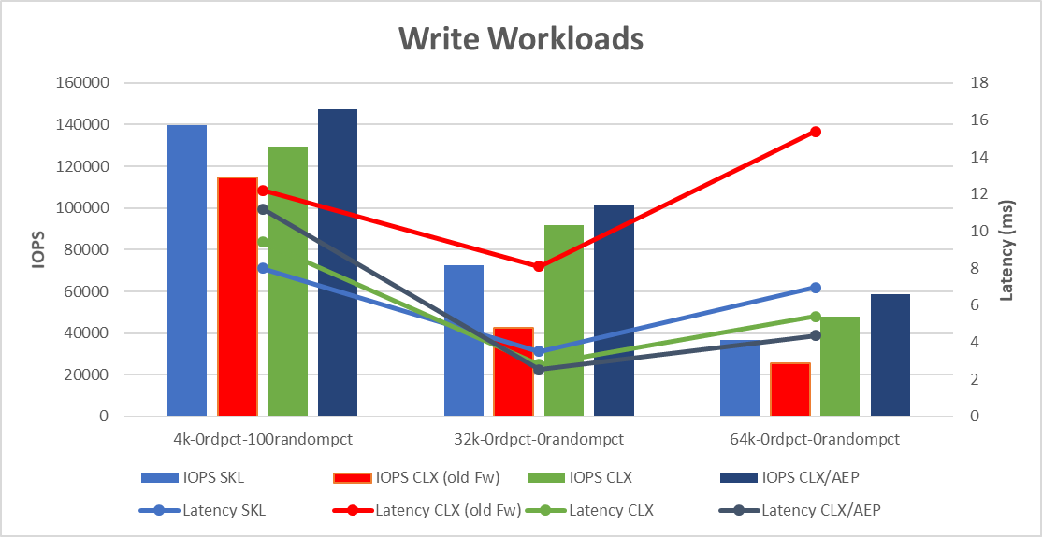
HCIBench Results
HCIBench Results – SKL Vs CLX Vs CLX/AEP Configurations
The target of these tests was basically to show the difference between the UCP HC with CLX and CLX+AEP. However, previous results from Skylake were added just as a reference point.
These results with HCIBench shows some performance gains between the configuration with CLX CPU Vs the one with CLX + AEP. However, the difference is more noticeable when running VMmark benchmarks where we can see that a configuration with AEP (Persistent Memory) can run up to 33% more VMs compared with a traditional cluster with DDR4 only. Results of VMmark benchmarks can be found on separate document. (Hitachi UCP HC – Intel Select - VMmark Benchmarks Results-05142019.pptx)

Slide 32
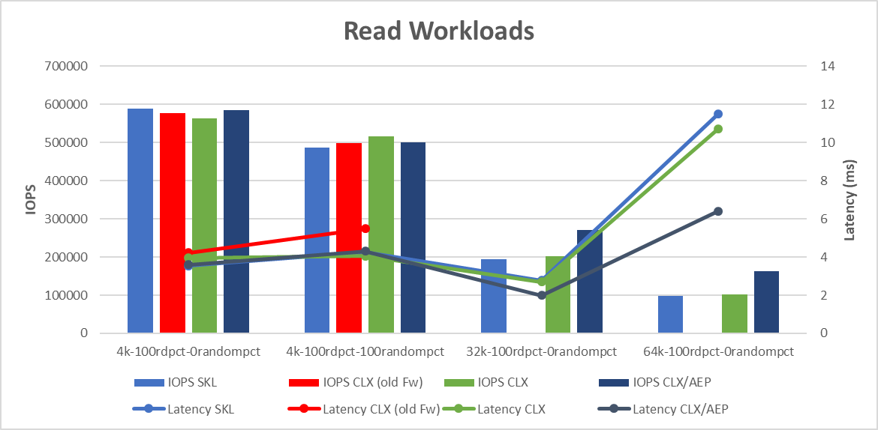
HCIBench Results
HCIBench Results – SKL Vs CLX Vs CLX/AEP Configurations

Slide 33
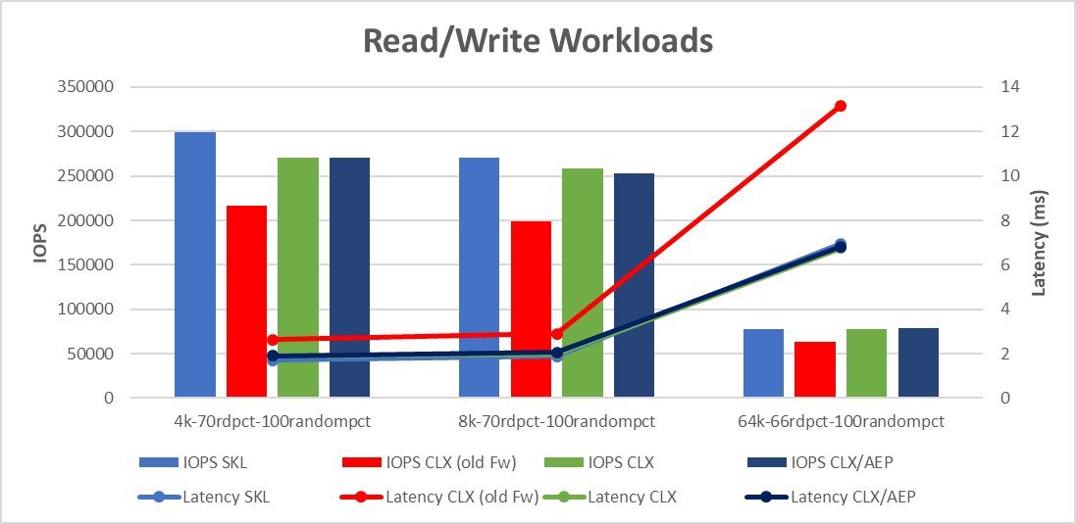
HCIBench Results
HCIBench Results – SKL Vs CLX Vs CLX/AEP Configurations

Slide 34
HCIBench Results
HCIBench Results – SKL Vs CLX Vs CLX/AEP Configurations
The table below shows all the results shown in previous charts.

Slide 35
Test Cases : HCIBench Workloads
UCP HC All-NVMe –Cascade/AEP
In addition to running typical workload applications, the following workloads were executed: 4-corners, oltp
And these tests were executed only on the two configurations with Cascade CPU (Base with CLX and Plus with CLX/AEP):
iorate=curve,curve=(10,20,30,50,80,90,100),elapsed=600

Slide 36
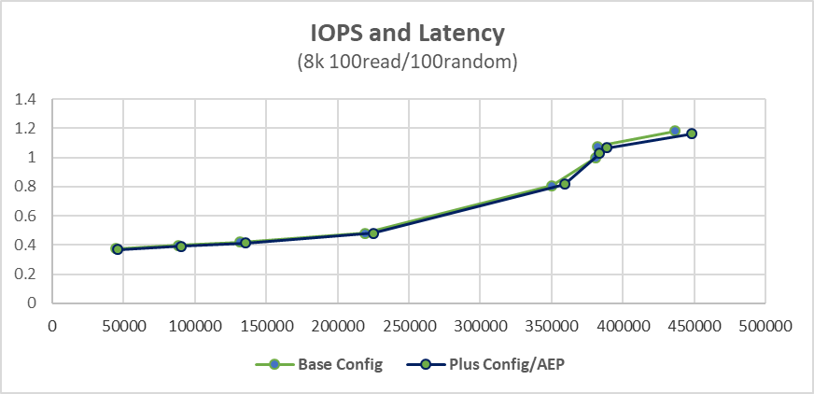
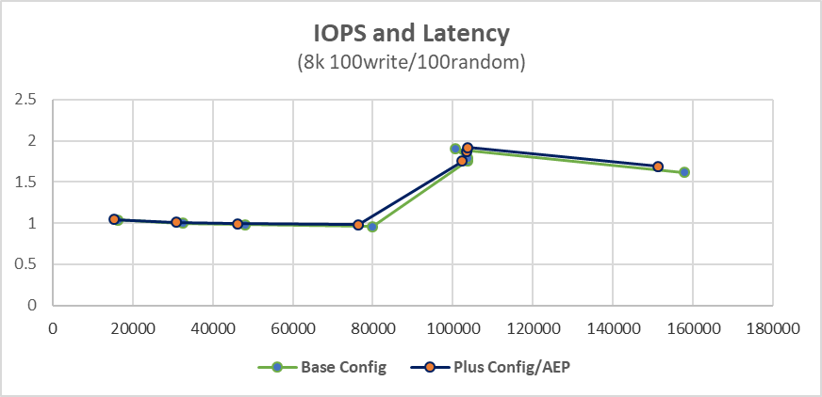
HCIBench Results
HCIBench Results – 4 corners
Results show IOPS and latency very similar for both configurations (CLX and CLX+AEP).

Slide 37
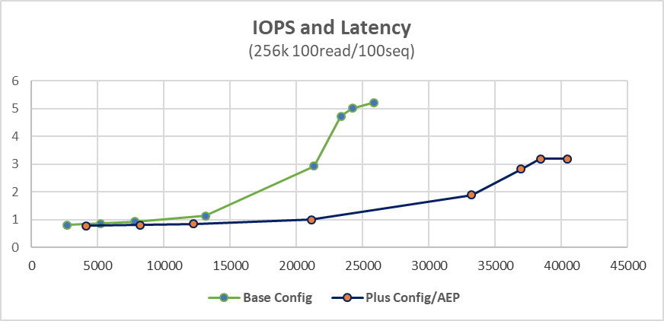
HCIBench Results
HCIBench Results – 4 corners/ OLTP/ and 70%
For large block size, sequential, we can see that the configuration with AEP shows better results in IOPS and latency.

Slide 38
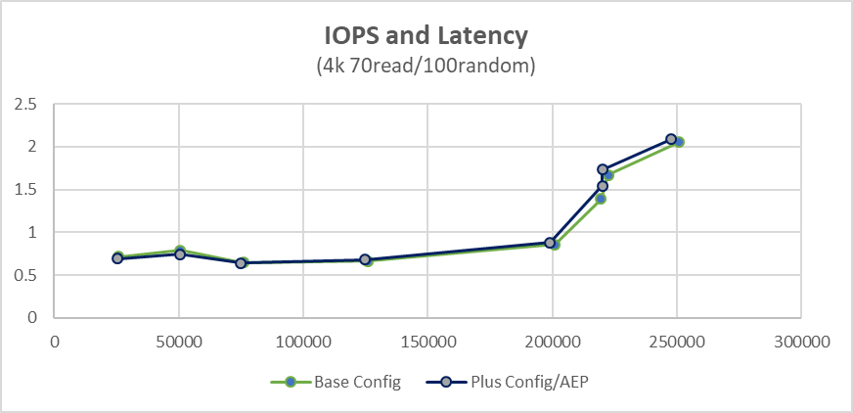
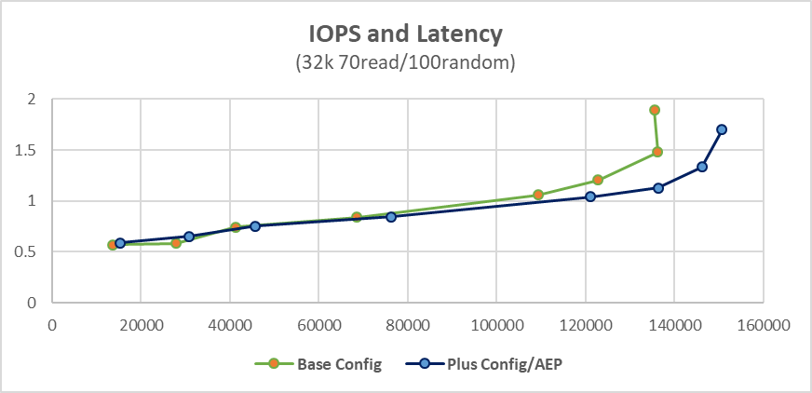
HCIBench Results
HCIBench Results – 4 corners/ OLTP/ and 70%
Results show IOPS and latency very similar for both configurations (CLX and CLX+AEP).

Slide 39
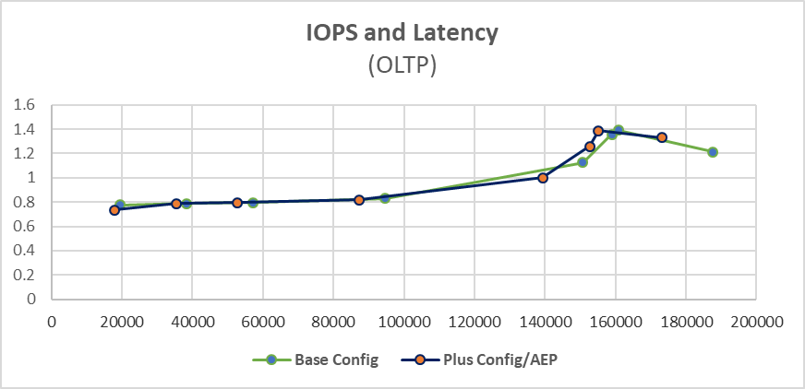
Summary of VMmark Results
HCIBench Results – SKL Vs CLX Vs CLX/AEP Configurations
Results show IOPS and latency very similar for both configurations (CLX and CLX+AEP).

Slide 40
Summary of VMmark Results
HCIBench Results – SKL Vs CLX Vs CLX/AEP Configurations
Table below shows the all the results shown in previous charts.

Slide 41
Findings/Conclusions

Slide 42
Findings/Conclusions
HCIBench on UCP HC SATA SSD Vs All-NVMe :
All-NVMe outperforms SATA SSD on write intensive workloads, achieving two to three times more IOPS and up to three times lower latency.
OLTP benchmark on UCP HC SATA SSD Vs All-NVMe:
For OLTP applications, an All-NVMe solution shows about 90% more transactions per minute (TPM) than a cluster based on SATA SSD.
An All-NVMe solution can be even about 40% lower in cost (TPM/dollar).

Slide 43
Findings/Conclusions
HCIBench on UCP HC with Cascade CPU and AEP:
Results with HCIBench shows some performance gains between the configuration with CLX CPU Vs the one with CLX + AEP. However, the difference is more noticeable when running VMmark benchmarks where we can see that a configuration with AEP (Persistent Memory) allows not only better VM density, but also allows running VMs with higher memory resources and still meeting SLA’s by VMware VMmark.
From cost perspective, it depends on the memory population and capacity of the DDR4 DIMMs used, we can see that just changing from a Base config to a Plus config we can easily get up to 33% more VM density.

Slide 44
Questions and Discussion

Slide 45
Thank You

Slide 46
Miscellaneous

Slide 47
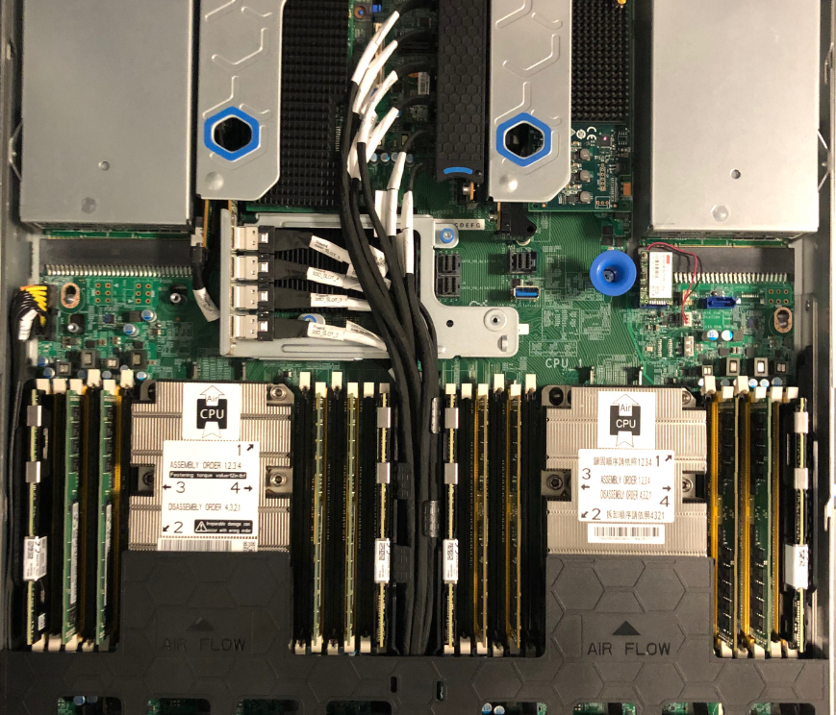
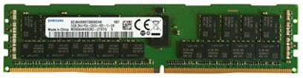
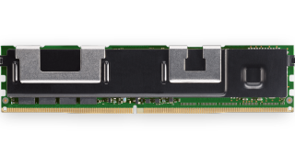
CLX/AEP Memory Population
DS120 with AEP DIMM Population 1-1-1 (8 x 32GB DDR4 + 4 x 128GB AEP)
DDR4 R-DIMM Memory
Intel Optane DC Persistent Memory

Slide 48
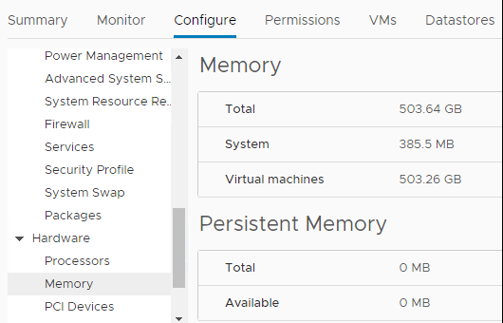
CLX/AEP Memory Population
DS120 with AEP DIMM Population 1-1-1 (8 x 32GB DDR4 + 4 x 128GB AEP)
DDR4 + AEP topology seen from ESXi (configured in Memory Mode)
[root@v124n-host3:~] /opt/intel/bin/ipmctl show -topology
DimmID | MemoryType | Capacity | PhysicalID| DeviceLocator
==============================================================================
0x0020 | Logical Non-Volatile Device | 126.3 GiB | 0x0048 | CPU0_C0
0x0120 | Logical Non-Volatile Device | 126.3 GiB | 0x004e | CPU0_F0
0x1020 | Logical Non-Volatile Device | 126.3 GiB | 0x0054 | CPU1_C0
0x1120 | Logical Non-Volatile Device | 126.3 GiB | 0x005a | CPU1_F0
N/A | DDR4 | 32.0 GiB | 0x0044 | CPU0_A0
N/A | DDR4 | 32.0 GiB | 0x0046 | CPU0_B0
N/A | DDR4 | 32.0 GiB | 0x004a | CPU0_D0
N/A | DDR4 | 32.0 GiB | 0x004c | CPU0_E0
N/A | DDR4 | 32.0 GiB | 0x0050 | CPU1_A0
N/A | DDR4 | 32.0 GiB | 0x0052 | CPU1_B0
N/A | DDR4 | 32.0 GiB | 0x0056 | CPU1_D0
N/A | DDR4 | 32.0 GiB | 0x0058 | CPU1_E0

Slide 49
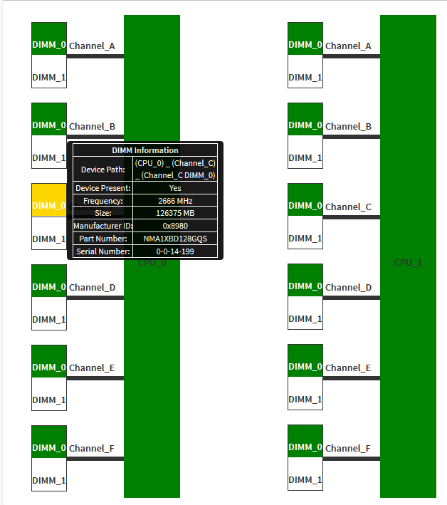
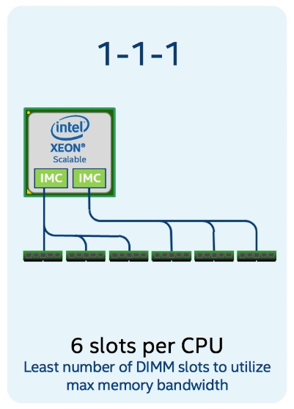
CLX/AEP Memory Population
DS120 with AEP DIMM Population 1-1-1 (8 x 32GB DDR4 + 4 x 128GB AEP)
DDR4 + AEP seen from BMC

Slide 50
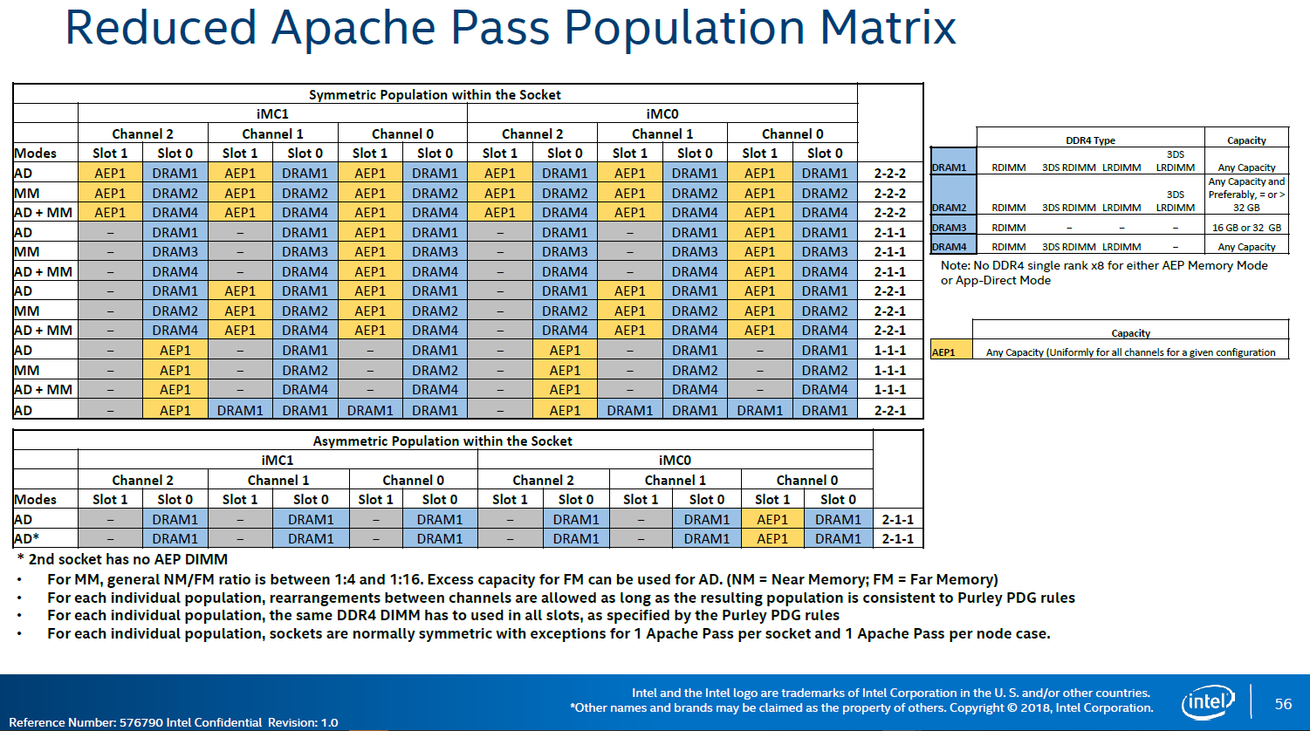
AEP Population Matrix

